Slide 1
RUNGTA COLLEGE OF DENTAL SCIENCES & RESEARCH
TITLE OF THE TOPIC: AMALGAM
DEPARTMENT OF CONSERVATIVE DENTISTRY AND ENDODONTICS

Slide 2
Specific learning Objectives
At the end of this presentation the learner is expected to know ;
Core areas* | Domain ** | Category #
COMPOSITION CLASSIFICATION OF AMALGAM | COGNITIVE | MUST KNOW
INDICATIONS ADVANTAGES METALLURGICAL PHASES | PSYCHOMOTOR | NICE TO KNOW
TERMONOLOGIES | AFFECTIVE | DESIRE TO KNOW

Slide 3
Table of Content
HISTORICAL BACKGROUND
CONSTITUENTS
CLASSIFICATION OF AMALGAM ALLOY
INDICATION AND CONTRAINDICATION
ADVANTAGES AND DISADVANTAGES
METALLURGICAL PHASES
DIMENSIONAL CHANGES
REFERENCES

Slide 4
METALLURGICAL PHASES

Slide 5
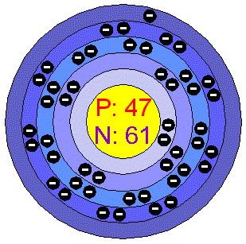
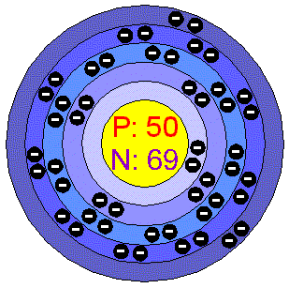
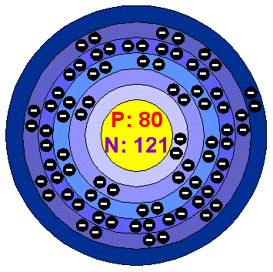
PHASES
STOICHIOMETRIC
FORMULA
NUMBER OF ATOMS
γ
Ag₃Sn
γ₁
Ag₂Hg₃
γ₂
Sn₈Hg

Slide 6
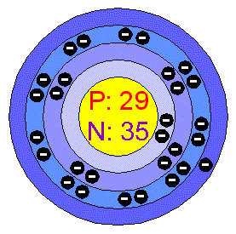
PHASES
_{STOICHIOMETRIC FORMULA}
_{NUMBER OF ATOMS}
ε
Cu₃Sn
η
Cu₆Sn₅
Silver-Copper Eutectic
Ag-Cu

Slide 7
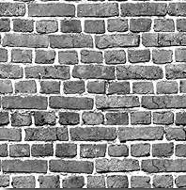
Basic Composition
A silver-mercury matrix containing filler particles of silver-tin
Filler(bricks):
Ag₃Sn called gamma
can be in various shapes
irregular (lathe-cut), spherical, or a combination
Matrix:
Ag₂Hg₃ called gamma 1
cement
Sn₈Hg called gamma 2
voids
Phillip’s Science of Dental Materials 2003

Slide 8
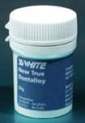
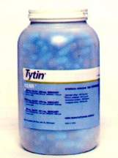
AMALGAMATION AND BASIC SETTING REACTIONS
Conventional low-copper alloys
Admixed high-copper alloys
Single composition high-copper alloys

Slide 9
CONVENTIONAL LOW-COPPER ALLOYS
Dissolution and precipitation
Hg dissolves Ag and Sn from alloy
Intermetallic compounds formed
Ag-Sn Alloy
Hg
Hg
Sn
Ag
Ag
Ag
Sn
Ag-Sn Alloy
Sn
Ag-Sn Alloy
Mercury (Hg)
Ag₃Sn + Hg ⇒ Ag₃Sn + Ag₂Hg₃ + Sn₈Hg
γ
γ
γ1
γ2
Phillip’s Science of Dental Materials 2003

Slide 10
CONVENTIONAL LOW-COPPER ALLOYS
Gamma (γ) = Ag₃Sn
unreacted alloy
strongest phase and corrodes the least
forms 30% of volume of set amalgam
Hg
Ag-Sn Alloy
Hg
Hg
Ag
Sn
Ag
Ag
Sn
Ag-Sn Alloy
Sn
Ag-Sn Alloy
Mercury
Ag₃Sn + Hg ⇒ Ag₃Sn + Ag₂Hg₃ + Sn₈Hg
γ
γ
γ1
γ2
Phillip’s Science of Dental Materials 2003

Slide 11
CONVENTIONAL LOW-COPPER ALLOYS
Gamma 1 (γ₁) = Ag₂Hg₃
matrix for unreacted alloy and 2nd strongest phase
10 micron grains binding gamma (γ)
60% of volume
Ag-Sn Alloy
γ₁
Ag-Sn Alloy
Ag-Sn Alloy
Ag₃Sn + Hg ⇒ Ag₃Sn + Ag₂Hg₃ + Sn₈Hg
γ
γ
γ1
γ2
Phillip’s Science of Dental Materials 2003

Slide 12
CONVENTIONAL LOW-COPPER ALLOYS
Gamma 2 (γ₂) = Sn₈Hg
weakest and softest phase
corrodes fast, voids form
corrosion yields Hg which reacts with more gamma (γ)
10% of volume
volume decreases with time due to corrosion
Ag-Sn Alloy
Ag-Sn Alloy
Ag-Sn Alloy
γ₂
Ag₃Sn + Hg ⇒ Ag₃Sn + Ag₂Hg₃ + Sn₈Hg
γ
γ
γ1
γ2
Phillip’s Science of Dental Materials 2003

Slide 13
CONVENTIONAL LOW-COPPER ALLOYS
Ag₃Sn + Hg ⇒ Ag₃Sn + Ag₂Hg₃ + Sn₈Hg
γ
γ
γ₁
γ₂
(30%)
(60%)
(10%)
Ag-Sn Alloy
Ag-Sn Alloy
Ag-Sn Alloy
Hg
Hg
Sn
Ag
Ag
Ag
γ₁
Sn
Sn
Ag-Sn Alloy
Ag-Sn Alloy
Ag-Sn Alloy
Ag-Sn Alloy
Ag-Sn Alloy
Ag-Sn Alloy
γ₂
Mercury (Hg)

Slide 14
ADMIXED HIGH-COPPER ALLOYS
Eutectic
an alloy in which the elements are completely soluble in liquid solution but separate into distinct areas upon solidification
Ag enters Hg from Ag-Cu spherical eutectic particles
Both Ag and Sn enter Hg from Ag₃Sn particles
Ag-Cu Alloy
Hg
Hg
Ag
Ag
Ag
Ag
Sn
Ag-Sn Alloy
Sn
Ag-Sn Alloy
Mercury
Ag₃Sn + Ag-Cu + Hg ⇒ Ag₃Sn + Ag-Cu + Ag₂Hg₃ + Cu₆Sn₅
γ
γ
γ1
η
Phillip’s Science of Dental Materials 2003

Slide 15
ADMIXED HIGH-COPPER ALLOYS
Sn diffuses to surface of Ag-Cu particles
reacts with Cu to form (eta) Cu₆Sn₅ (η)
around unconsumed Ag-Cu particles
η
Ag-Cu Alloy
Ag-Sn Alloy
Ag-Sn Alloy
Ag₃Sn + Ag-Cu + Hg ⇒ Ag₃Sn + Ag-Cu + Ag₂Hg₃ + Cu₆Sn₅
γ
γ
γ1
η
Phillip’s Science of Dental Materials 2003

Slide 16
ADMIXED HIGH-COPPER ALLOYS
Gamma 1 (γ₁) (Ag₂Hg₃) surrounds (η) eta phase (Cu₆Sn₅) and gamma (γ) alloy particles (Ag₃Sn)
η
Ag-Cu Alloy
Ag-Sn Alloy
Ag-Sn Alloy
γ₁
Ag₃Sn + Ag-Cu + Hg ⇒ Ag₃Sn + Ag-Cu + Ag₂Hg₃ + Cu₆Sn₅
γ
γ
γ1
η
Phillip’s Science of Dental Materials 2003

Slide 17
ADMIXED HIGH-COPPER ALLOYS
Ag₃Sn + Ag-Cu + Hg ⇒ Ag₃Sn + Ag-Cu + Ag₂Hg₃ + Cu₆Sn₅
γ
γ
γ1
η
Ag-Cu Alloy
η
Ag-Cu Alloy
η
Ag-Cu Alloy
Hg
Ag
Ag
Hg
Ag
Ag
Sn
Ag-Sn Alloy
Sn
Ag-Sn Alloy
Ag-Sn Alloy
Ag-Sn Alloy
Ag-Sn Alloy
Ag-Sn Alloy
Mercury
γ₁

Slide 18
SINGLE COMPOSITION HIGH-COPPER ALLOYS
Gamma sphere (γ) (Ag₃Sn) with epsilon coating (ε) (Cu₃Sn)
Ag and Sn dissolve in Hg
Very little Cu dissolves in Hg
ε
Ag-Sn Alloy
Ag
Sn
Sn
Ag
Ag-Sn Alloy
Ag-Sn Alloy
Mercury (Hg)
Ag₃Sn + Cu₃Sn + Hg ⇒ Ag₃Sn + Cu₃Sn + Ag₂Hg₃ + Cu₆Sn₅
γ
ε
γ
ε
γ1
η
Phillip’s Science of Dental Materials 2003

Slide 19
SINGLE COMPOSITION HIGH-COPPER ALLOYS
Gamma 1 (γ₁) (Ag₂Hg₃) crystals grow binding together partially- dissolved gamma (γ) alloy particles (Ag₃Sn)
Epsilon (ε) (Cu₃Sn) develops crystals on surface of gamma particle (Ag₃Sn) in the form of eta (η) (Cu₆Sn₅)
reduces creep
prevents gamma-2 formation
Ag-Sn Alloy
η
Ag-Sn Alloy
Ag-Sn Alloy
γ₁
Ag₃Sn + Cu₃Sn + Hg ⇒ Ag₃Sn + Cu₃Sn + Ag₂Hg₃ + Cu₆Sn₅
γ
ε
γ
ε
γ1
η
Phillip’s Science of Dental Materials 2003

Slide 20
Ag₃Sn + Cu₃Sn + Hg ⇒ Ag₃Sn + Cu₃Sn + Ag₂Hg₃ + Cu₆Sn₅
γ
ε
γ
ε
γ1
η
ε
Ag-Sn Alloy
Ag
Mercury (Hg)
Sn
Sn
Ag-Sn Alloy
Ag
Ag-Sn Alloy
Mercury (Hg)
Ag-Sn Alloy
Mercury (Hg)
Ag-Sn Alloy
Ag-Sn Alloy
Mercury (Hg)
Ag-Sn Alloy
SINGLE COMPOSITION HIGH-COPPER ALLOYS
η
Ag-Sn Alloy
Ag-Sn Alloy
γ₁

Slide 21
TAKE HOME MESSEGE/ FOR THE TOPIC COVERED (SUMMARY)
Dental amalgam are widely used by the dental profession in most parts of the world
Some countries like swedan, Canada and Germany, uk have either banned or imposed serious limitation on amalgam usage
The American dental association council on scientific affairs has conclude that both amalgam and composite materials are considered safe and effective for tooth restoration .

Slide 22
Question & Answer Session
Students should be given opportunity to ask question for clarifying for their understand/ confusions. Teachers must spend 5-10 minutes for this to improve the output.

Slide 23
REFERENCES
STURVEDANTS art and science of operative dentistry text book of operative dentistry NISHA GARG AND AMIT GARG

Slide 24
THANK YOU

